Slide 1

How to Set a Veterans Affairs Grave Marker
By Kassidy, TSGS IT Coordinator

Slide 2
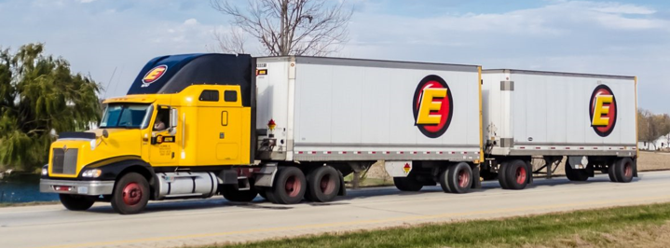
How it arrives…
You’ll get a call from Estes saying they have a delivery for you.
Meet them at a convenient, easily accessible location.
Have a plan on how you’ll transport the grave marker.

Slide 3
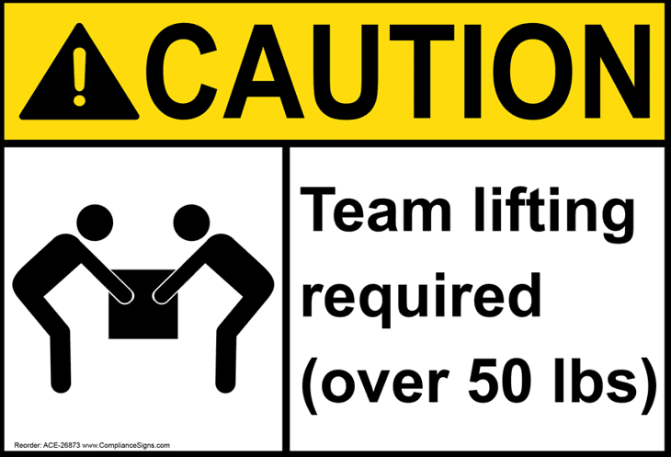
Team Lift!
The grave markers are about 260 lbs.
Have a plan on how you’ll transport it from the truck, and, later, to the cemetery.
Consider having multiple people help you lift and set the marker.

Slide 4
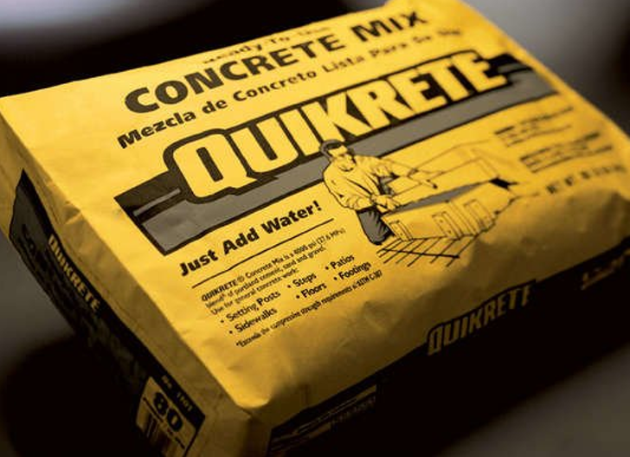
OPTION 1 – Ready, Set, Go!
The grave marker arrived and now it’s ready to be set at the cemetery.
One way to set the grave marker is by simply digging a hole to put the marker in and filling the surrounding hole with dry concrete.
Moisture from the ground (and rain) will harden the concrete.

Slide 5
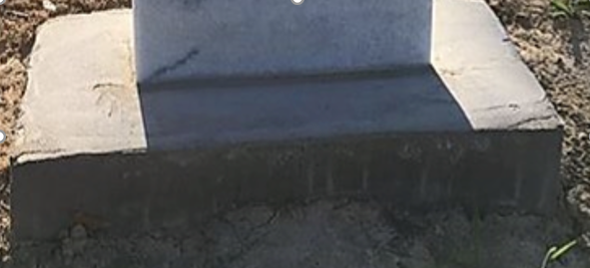
OPTION 2 – The Bases Are Covered
Option 2 takes a bit more work.
First, build a wooden base that comes out a few inches more than the grave marker (about 4 in. or so all the way around). The base should be close to a foot high.
Second, drive about an 18 in. piece of rebar into the ground, at diagonal corners of the grave marker. Drive the rebar about a foot in the ground (so 8 in. above ground, inside of form).
Then, take layers of foam, slightly taller than the form and about 1 in. wider and longer than the stone, and place them in the center of the form.
Next, pour mixed concrete into the form. Make sure there are no air voids in the concrete. Pour concrete to the top of the form and level it off.

Slide 6

OPTION 2 - Continued
Once the concrete form has cured (allow at least 48 hrs.), here’s what to do next:
Now, remove the foam (it may need to be chipped away).
Remove the wooden form and place the stone in the cavity left by the foam, making sure it’s level and plumb.
Now mix mortar and fill up the space in between stone and concrete form, making sure there are no air spaces.
For a smoother appearance, cover top of form with a thin layer of mortar and smooth it out until it looks good to you!

Slide 7

Option 1 Pros
Option 1 is easier.
Option 1 takes less concrete.
Option 1 takes less time.
Option 1 can allow stone to be set immediately (no wait time).

Slide 8

Option 2 Pros
To some, the form around the stone in Option 2 may look more professional.
The biggest pro of option 2 is that, for mowing season, it keeps the stone safe. The mower may hit the concrete form, but not the grave marker.

Slide 9
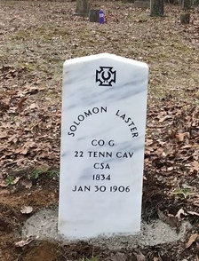
A Set Up!
No matter how you decide to set the veteran’s grave marker, rest assured that the marker, now legible, will allow individuals to locate the service member’s marker more readily.
You have actively ensured that the veteran’s memory remains alive, while honoring them for their service.

